Slide 1
DFAS Robotics Processing Automation and Data Analytics
Ms. Audrey Davis
Director, DFAS
Ms. Shirley Reed
Deputy Site Director, DFAS Columbus
September 9, 2021

Slide 2
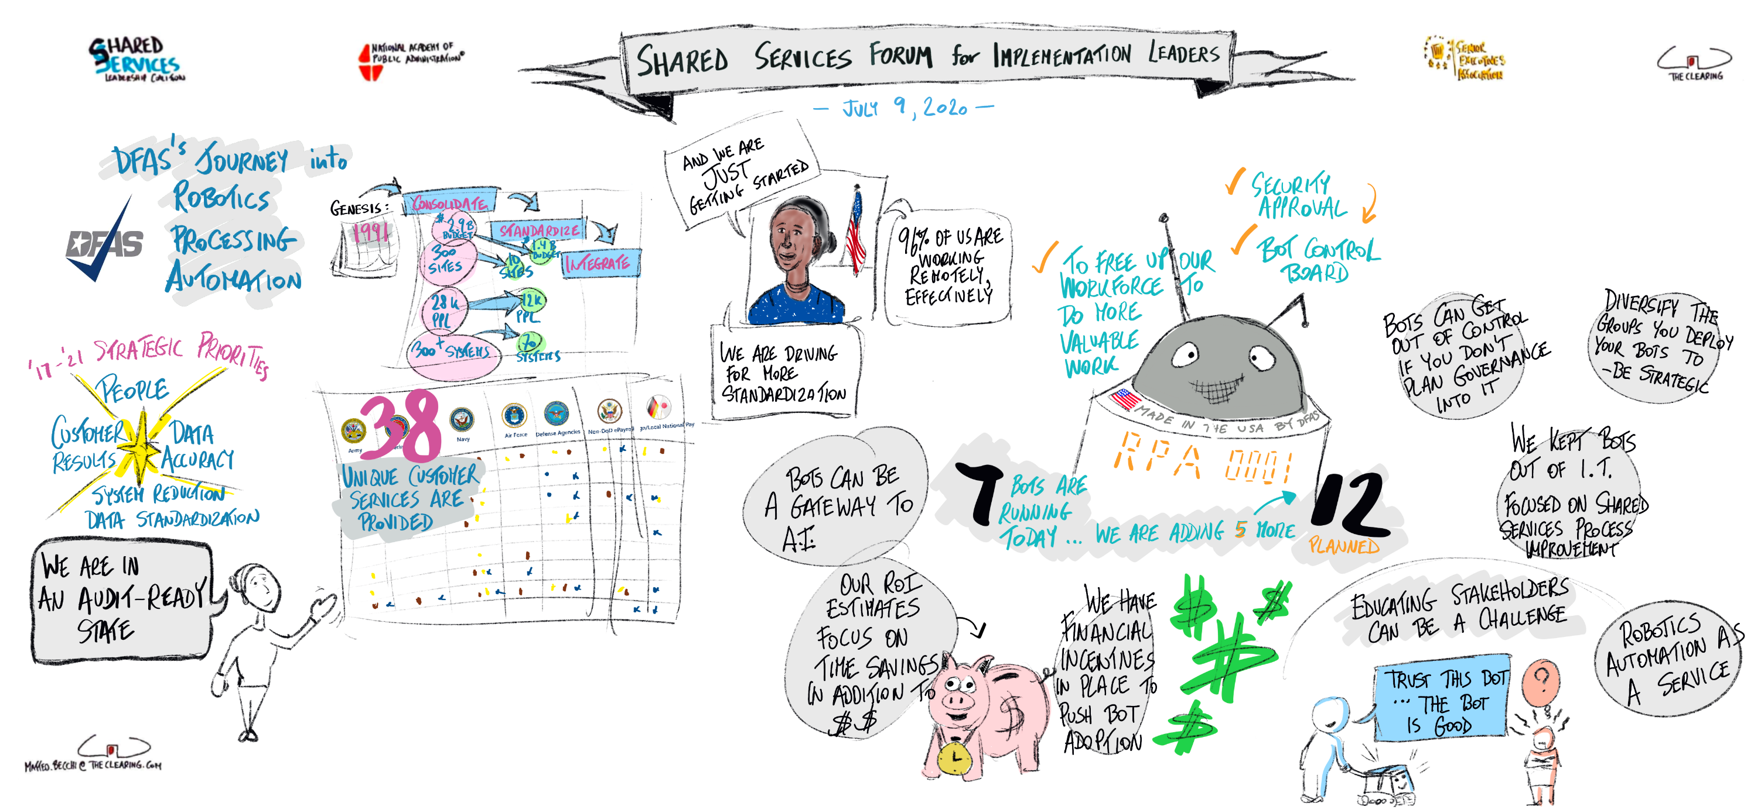
Our Last Time Together

Slide 3


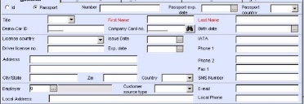


DFAS Robotics Process Automation (RPA)
Why: Cost Effective Risk Management
Improve internal controls
Increase speed and accuracy
Enhance standardization
Reduce manual labor
What: Prime Targets
Low analysis, highly manual processes
Repetitive tasks
Data entry prone to error
Large audit samples
How: Leveraging available Bots to minimize redundancy
DoD Collaboration
Advana
Enterprise SharePoint Site
Enterprise Use Cases
RPA
21 Enterprise Bots
9 Shared Bots
37 Use Cases
Artificial Intelligence
Step
Step
Next
Next
Adobe Interactive Forms
SQL Scripting
Macros
Bots – Annual Hours Saved*
Debt Letter Bot 2,000 Hours
SOD Audit Bot 2,200 Hours
Bankruptcy Bot 2,600 Hours
DDRS-B Army 3,000 Hours
CEDMS Audit Bot 9,000 Hours
EFT Validation Bot 11,250 Hours
ODS Duplicate Payment Check 16,600 Hours
*Hours saved is anticipated annual savings based on current manual processing times.

Slide 4
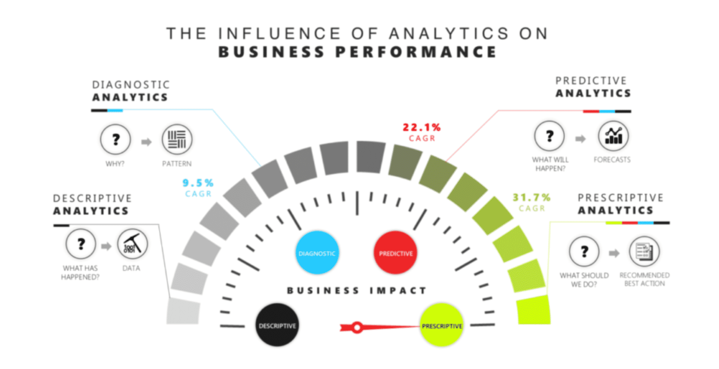
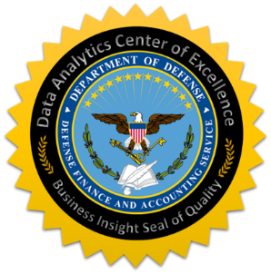
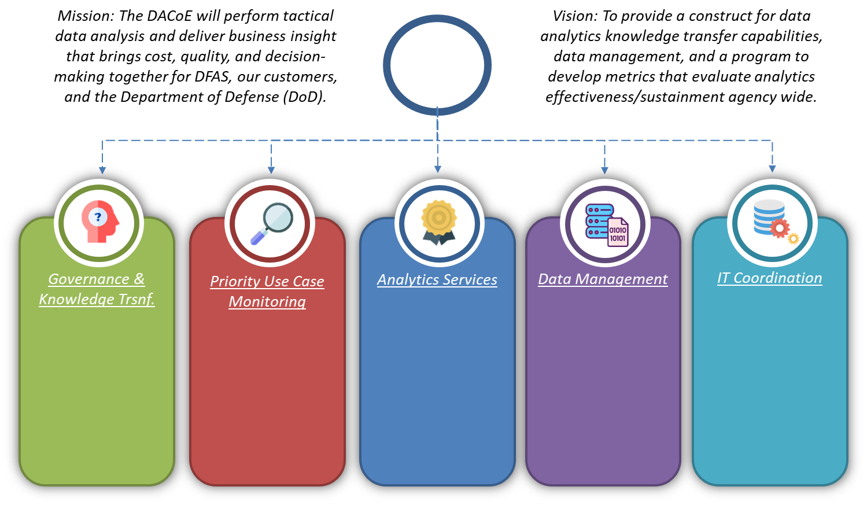
DFAS Data Analytics
Transform from historical data gatherers who tell customers what happened, to data analysts performing sophisticated analysis providing business insight and driving efficiencies for our customers.
DoD Data Strategy
Established organizational structure & framework
Created Community of Practice
Defined DFAS universe of data
Leveraged Advana

Slide 5
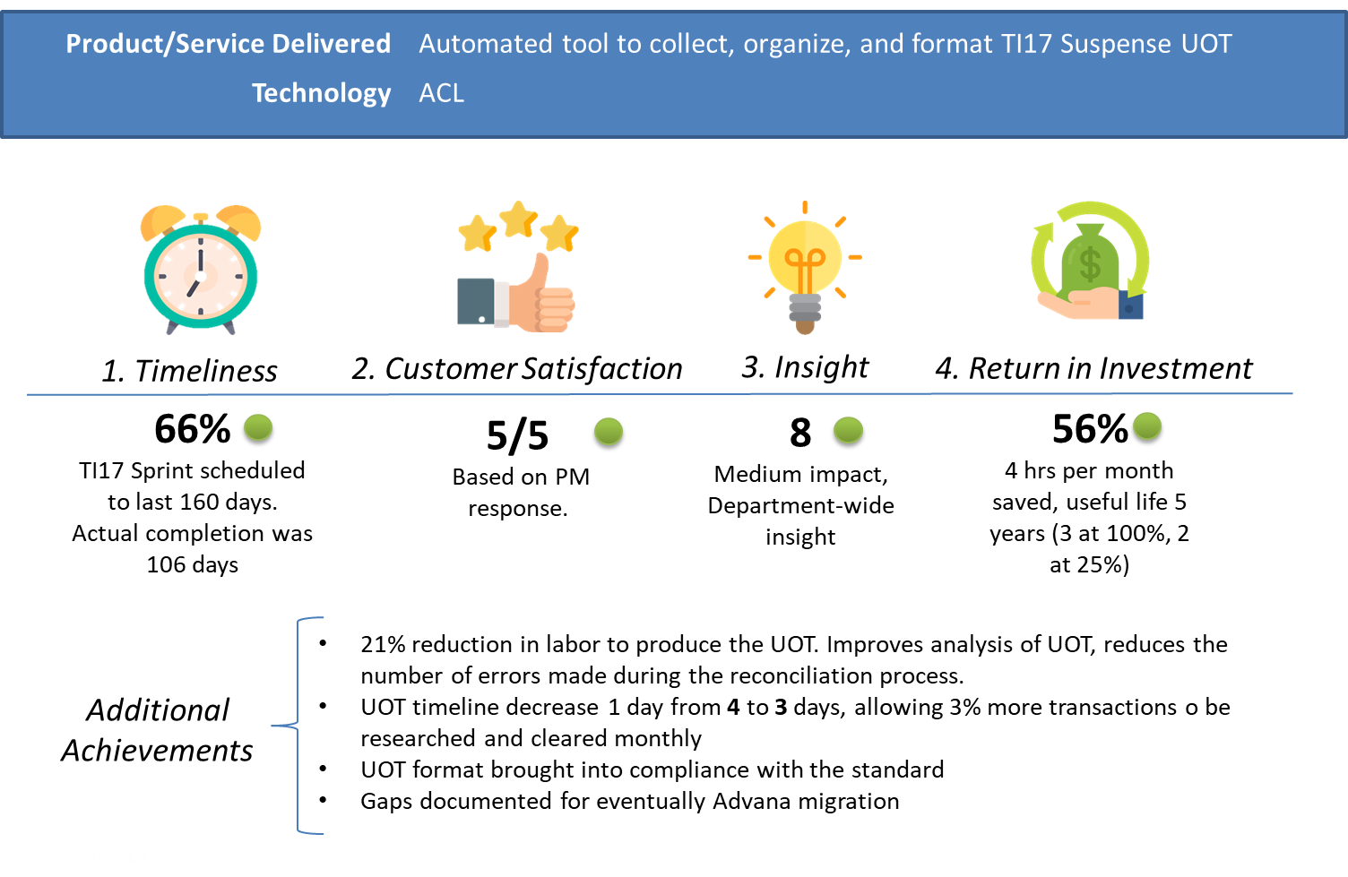
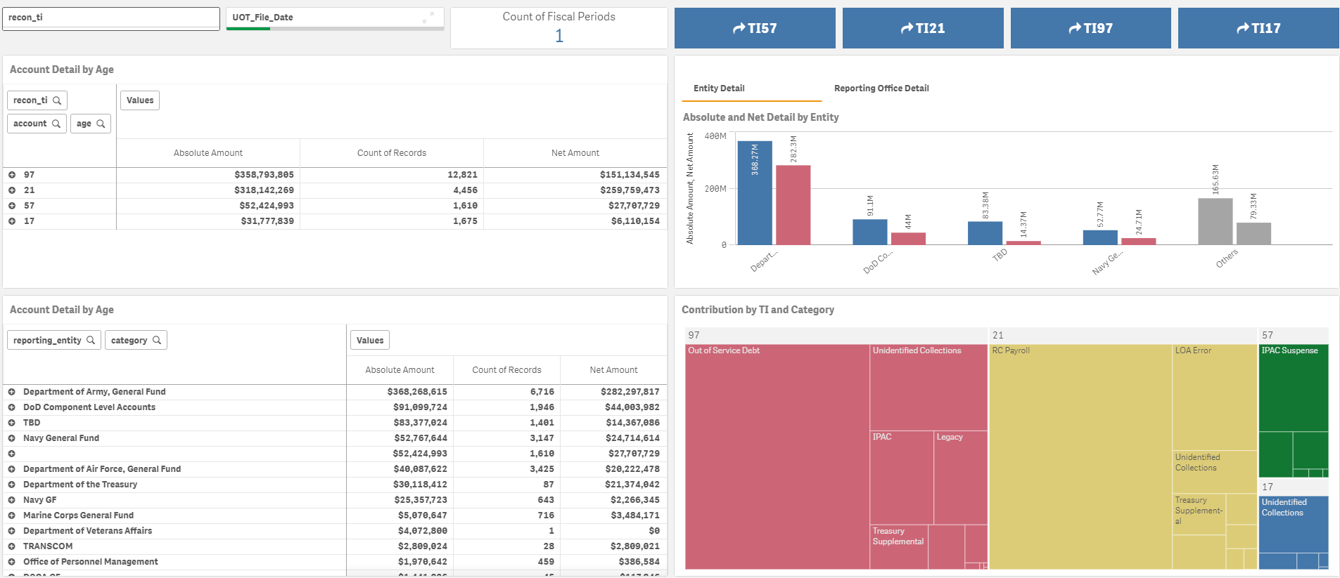
DFAS Data Analytics: Suspense UoT Automation & Dashboard
Problem Statement
Current processes for producing the Suspense UoT are manual and time intensive, requiring up to 60 days for producing a Suspense UoT. Reducing this timeline and improving data quality of the Suspense UoT are important factors in achieving clean audit opinions.
Outcome

Slide 6
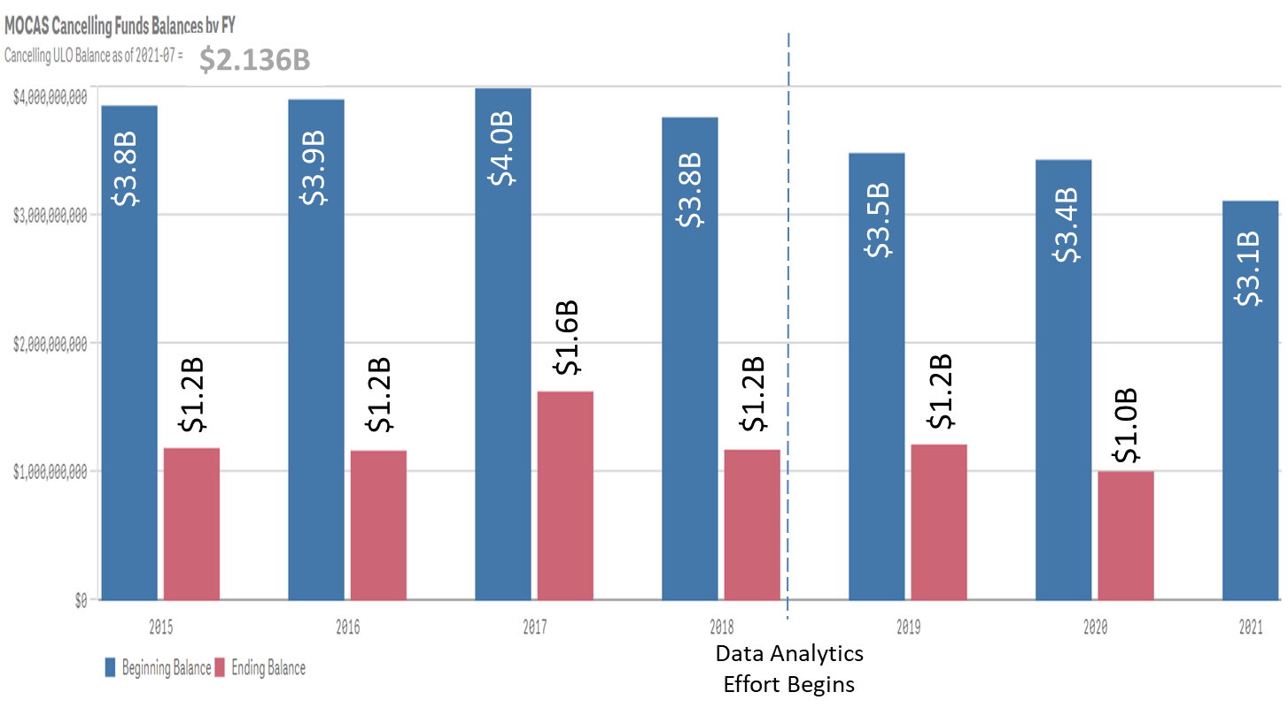
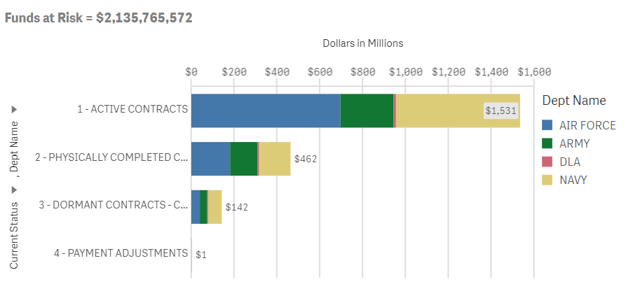
DFAS Data Analytics: MOCAS Cancelled/Cancelling Funds
Problem Statement
Driven by an upward trend of cancelled funds, the DFAS CO Data Analytics cell in partnership with ADVANA focused on MOCAS data, providing new intelligence and dashboard visibility.
Outcome
Performed comprehensive analysis on cancelling funds
MOCAS Cancelled Funds Working Group (DFAS, DPC, Comptroller, DCMA)
DCMA updating Funds Lifecycle Management procedures
MOCAS Dashboards live in Advana
Cancelled Funds Phase 3 – DAR-Q to MOCAS

Slide 7

Step Back Approach
1.) What are other use cases we can / should consider?
2.) How do we make Data Analytics capabilities part of
our service offerings?

Slide 8
DFAS Robotics Processing Automation and Data Analytics
Ms. Audrey Davis
Director, DFAS
Ms. Shirley Reed
Deputy Site Director, DFAS Columbus
September 9, 2021

